Slide 1
ACT Audit Office
Information Session
25 September 2026
audit.act.gov.au

Slide 2

Welcome and acknowledgement of country
We wish to acknowledge the Ngunnawal people as traditional custodians of the land we are meeting on and recognise any other people or families with connection to the lands of the ACT and region.
We wish to acknowledge and respect their continuing culture and the contribution they make to the life of this city and this region.
We would also like to acknowledge and welcome other Aboriginal and Torres Strait Islander people who may be attending today’s event.

Slide 3
Auditor-General address
Ajay Sharma PSM
ACT Auditor-General

Slide 4

Relationship between internal and external audit
Why a strong relationship matters
Importance to the public sector
Independence alongside cooperation

Slide 5
Financial Audit session
Clea Lewis
Assistant Auditor-General, Financial Audits

Slide 6
Purpose of Today's Discussion​
Better practices for audit committees​
Responsibilities of auditors​
Audit committee attendance by engagement leaders​
Key audit correspondence and what audit committees should focus on​
Common audit findings relating to internal audit and audit committees​
Why we assess internal audit​
What we assess​
Reliance on internal audit work and why it’s rare​
Notes:
Audit and Risk Committees play a critical role in supporting agency governance, risk management, internal controls and financial reporting.
From an external audit perspective, an effective internal audit function and an effective Audit and Risk Committee are important components of the overall control environment. They influence our assessment of governance arrangements, control risks and the amount and nature of audit work required.
Effective coordination between internal audit and the external auditor helps avoid unnecessary duplication and improves overall assurance coverage.
Today I will provide an overview of what we assess, how we engage with committees during the audit process, what we expect to see from a mature internal audit function, and some common findings and better practices observed across government agencies.

Slide 7
Better practices for audit committees​
Better practices include:
In-camera sessions with the external audit engagement leader​
Meetings between the committee chair and engagement leader​
Review of significant accounting judgements and estimates​
Formal assessment of internal audit effectiveness​
Periodic review of the committee charter and annual self-assessment of committee effectiveness​
Notes:
Some of the strongest committees across government demonstrate a proactive approach to governance rather than a compliance-focused approach. Some better practices observed by the Office from financial audit’s perspective include the following.
In-camera sessions with your agency’s engagement leader can allow unfiltered private discussions regarding management culture, governance concerns, audit quality and emerging risks.
Regular meetings between the Audit Committee Chair and Audit Engagement Leader can assist with communication and help ensure emerging issues are identified early and addressed in a timely manner.
Audit Committees should take an active role in reviewing significant accounting estimates and judgements and ensuring these are appropriately supported and explained.
A formal assessment of the internal audit function should be undertaken every 3 to 5 years to ensure it is effective.
A mature audit committee should also continuously evaluate both its own effectiveness and the effectiveness of the assurance functions it oversees.

Slide 8
Audit Committee Attendance by Engagement Leaders
External audit engagement leaders typically attend committee meetings to:
Provide progress updates
Discuss emerging risks
Explain audit findings
Discuss accounting issues
Answer external audit questions
May also attend for relevant agenda items that:
Improve understanding of the agency
Assist risk assessment
Provide context for audit planning
Notes:
The ACT Audit Office Terms of Engagement provide for Audit Office attendance at Audit Committee meetings as observers.
In practice, financial audit engagement leaders typically attend selected committee meetings during the audit cycle to provide an update on the progression of the audit, discuss significant risk areas, audit findings and key accounting matters.
Occasionally attendance at other agenda items can be valuable where those matters may affect governance arrangements, internal controls, fraud risks, major projects, new systems or significant organisational changes.
While engagement leaders may not always be able to provide a formal position on significant matters asked of them during meetings, they can often provide valuable insights on issues given their experience and involvement in auditing other entities and would be happy to assist with your queries where able to.

Slide 9
Key Audit Correspondence and What Committees Should Focus On​
Audit Strategy Document
Significant or new audit risks areas
Changes to reporting requirements
Interim and Final Audit Management Reports
Repeated findings
Overdue actions
Appropriateness of management comments
Audit Close Report
Significant errors or adjustments and underlying risks
Implications for reporting and governance
Management responses
Notes:
The Audit Office issues a number of different key documents to agencies during the financial audit process. To facilitate a smooth audit process, Audit Committees are encouraged to focus on a few key areas within these documents.
The Audit Strategy Document explains how the external audit will be performed, timing, key audit risks and the planned audit responses. Committees should focus on significant changes to reporting requirements and any new or significant audit risk areas (such as new or complex arrangements entered into during the year) and scrutinise their agency’s preparedness on these matters. As often the key to a smooth audit process is an agency’s preparation in relation to these matters.
The Interim and Final Audit Management Reports communicate significant findings identified during the audit in relation governance issues, control and reporting deficiencies. Committees should focus on recurring findings and root causes, overdue actions and challenging the appropriates of agency management comments.
The Audit Close Report communicates significant financial reporting matters required under auditing standards before the auditor's report is issued. Committees should focus less on technical accounting detail and more on understanding the underlying risks, management responses and implications for reporting and governance.

Slide 10
Common Findings Relating to Internal Audit and Audit Committees​
Common findings include:
Outdated internal audit charters​
Conflicts of interest and weak independence safeguards​
Lack of regular quality assessment​
Notes:
Examples from recent audits include out of date internal audit charters and charters or governance arrangements that failed to clearly address conflicts of interest.
From time to time we have also found that internal audit functions have failed to perform any quality assessments over their own work and operations.

Slide 11
Why We Assess Internal Audit​
Required under the Auditing Standards:
ASA 315 Identifying and Assessing the Risks of Material Misstatement​
ASA 610 Using the Work of Internal Auditors​
Notes:
Under ASA 315 Identifying and Assessing the Risks of Material Misstatement, if an entity has an internal audit function, the external auditor is required to obtain an understanding of that function as part of understanding the entity's system of internal control and assessing risks of material misstatement.
ASA 315 also specifically requires the auditor, during risk assessment procedures, to make enquiries of appropriate individuals within the internal audit function (if it exists) because they may have information relevant to identifying risks of material misstatement, including fraud risks.
And ASA 610 Using the Work of Internal Auditors deals with whether, and to what extent, the external auditor can use internal audit's work in performing the audit.

Slide 12
What We Assess​
Key areas include:
Independence and objectivity​
Internal audit charter​
Reporting lines and authority​
Competency and qualifications​
Risk-based planning​
Quality of audit work​
Quality assurance arrangements​
Follow-up of recommendations​
Audit committee oversight​
Notes:
When assessing internal audit, we focus on whether it is positioned to provide quality and objective independent assurance and whether the function operates in a manner consistent with the ACT Government Framework for Internal Audit Committees and Function, relevant Institute of Internal Auditors standards and better practice.
Recent ACT Audit Office findings have often related to weaknesses in internal audit charters, unclear accountability arrangements and inadequate safeguards where officers responsible for operational activities also coordinate internal audit activities.

Slide 13
Reliance on Internal Audit: Why It Is Rare​
External auditors may use internal audit work only where:
Internal audit is sufficiently independent
Auditors are competent and objective
Work is appropriately documented
Why reliance is often limited:
Different audit objectives
Timing differences
Differences in sampling methodologies or sample sizes
Work is relevant to the external audit
Quality can be independently assessed
Insufficient documentation
Independence concerns
Need to re-perform testing
Notes:
Australian Auditing Standard ASA 610 permits the Audit Office to use the work of internal audit in certain circumstances, where the internal audit function has been assessed as independent, effective and reliable. However, responsibility for the audit opinion remains solely with the Audit Office.
In practice, reliance is relatively rare. This is because there are differing audit objectives, timing issues (as it needs to align with the relevant F/S reporting period), differences in sampling methodologies and sample sizes, insufficient audit documentation and concerns about independence or objectivity.
Even when reliance is possible, external auditors are required to test some of the internal audit work before placing reliance on it and often the effort required to validate the work significantly reduces the efficiency benefits.
Therefore, agencies should not assume that a strong internal audit function will necessarily reduce external audit effort.

Slide 14
Performance Audit session
Brett Stanton
Assistant Auditor-General, Performance Audits

Slide 15
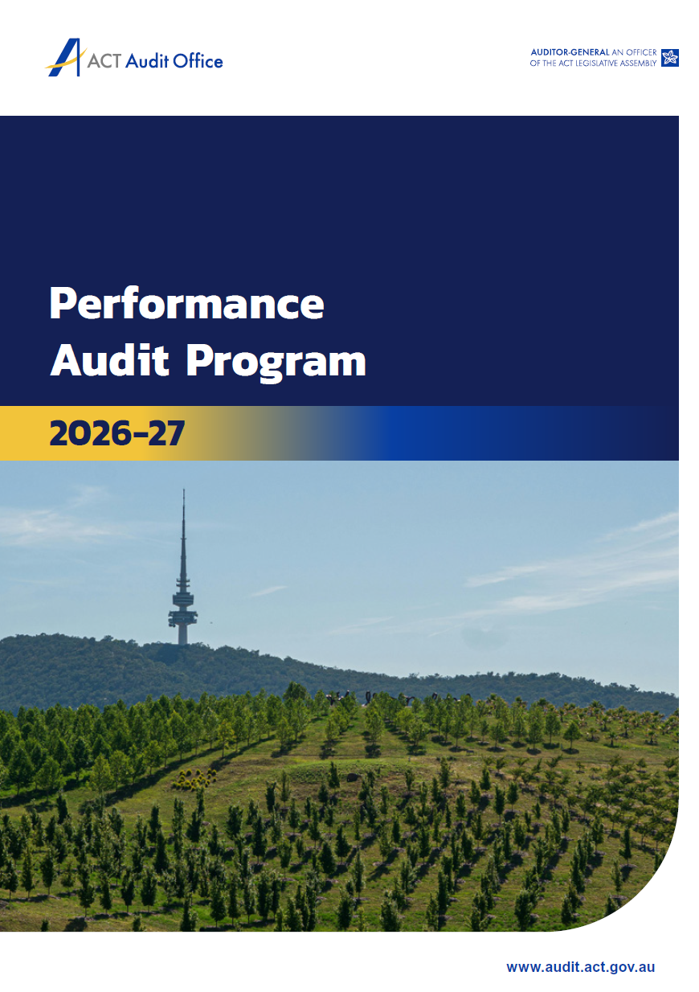
Development of the annual Performance Audit Program
Letters to Chairs asking for feedback on existing or potential topics (November/December)
Direct engagement with agency internal audit and risk management teams (January/February/March)
Draft program provided to Chairs for feedback (March)
Final program released (June)
~60 potential topics reviewed and considered
~20 topics included final program

Slide 16
Recommendations Implementation Dashboard
Available to anyone via the Audit Office website
Provides a single source to view recommendations from performance audits
Enables tracking of government response and reported implementation status
Could help identify overdue or outstanding recommendation responses
Complements agency processes for monitoring and implementing performance audit recommendations

Slide 17
Insights publications
Aim is to provide practical and concise guidance for agencies in relation to thematic issues arising from performance audit activity.
Have been produced since June 2022 with publications prepared in June and December annually.
Our most recent Insights publication is Engagement with Service Users with Different Communication & Support Needs.
Are announced in the Activity Summary prepared for Audit Committees and available on the Audit Office website.

Slide 18
Audit Committee Chair perspective
Will Laurie
Chair, Audit Office Audit and Risk Committee

Slide 19
Expectations of audit and risk committees
Take nothing as its looks; take everything on evidence.
There’s no better rule.
Charles Dickens, Great Expectations (1861)

Slide 20
Expectations of audit and risk committees
Integrity and Independence
  A given in the profession?
  Disclosure
Getting to the truth
  Culture
  Disagree agreeably
Consider the future
  Risk Horizons
  “Future of Corporate Risk”

Slide 21
Expectations of audit and risk committees
Communication
  The Models
  The Importance
Manage Relationships
  At the intersection
  Keep clear of managing
Recognise workloads
  Audit Committee support
  Busy Work – to be avoided

Slide 22
Questions
Audit Office Executives

Slide 23
Thank you
Please contact us at:
(02) 6207 0833
actauditorgeneral@act.gov.au
audit.act.gov.au

