Slide 1
ACCOUNTING STANDARDS UPDATE
October 2017
David Hardidge
Director – Technical and Treasury Products
Queensland Audit Office

Slide 2
Introduction
Mr Ajay Sharma, Acting Director, Financial Audits

Slide 3
Agenda
AASB 1058 Income for Not-for-profit Entities
IFRS 16 / AASB 16 Leases
IFRS 15 / AASB 15 Revenue from Contracts
with Customers
IFRS 9 / AASB 9 Financial Instruments
New accounting standards
AASB1059 Service Concession Arrangements: Grantors
Notes:
Agenda slide – please remove if not relevant.

Slide 4
New accounting standards

Slide 5
Upcoming changes
2018-19
2019
Beyond
AASB 15 Revenue For-profits
AASB 15 Revenue + AASB 1058 Income for NFPs
AASB 17 Insurance contracts
AASB 9 Financial Instruments
AASB 16 Leases
RDR
AASB 1059 Service concessions
Reporting entities

Slide 6
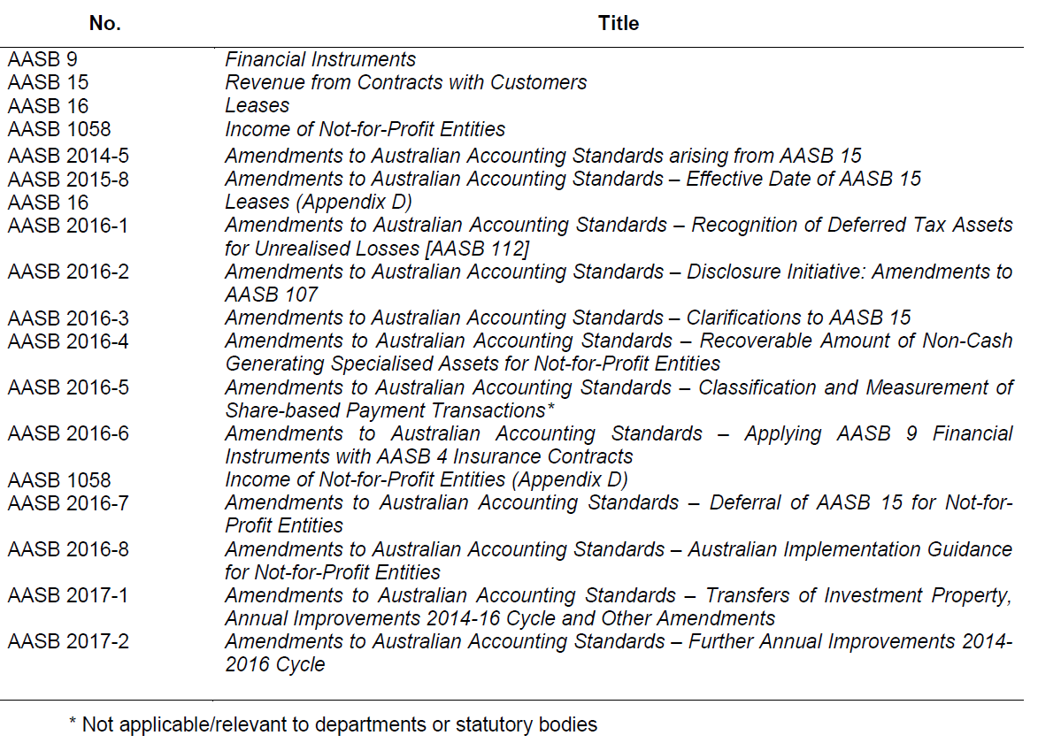
New standards not yet effective (31 March 2017)
Reconciliation of liabilities from financing activities
Impairment and fair value

Slide 7
New standards not yet effective
(issued 31 Mar 2017 to 30 Sep 2017)
AASB 17 Insurance Contracts
AASB 1059 Service Concession Arrangements: Grantors
AASB 2017-3 Clarifications to AASB 4
AASB Interpretation 23 Uncertainty over Income Tax Treatments
AASB 2017-4 Amendments to Australian Accounting Standards – Uncertainty over Income Tax Treatments

Slide 8
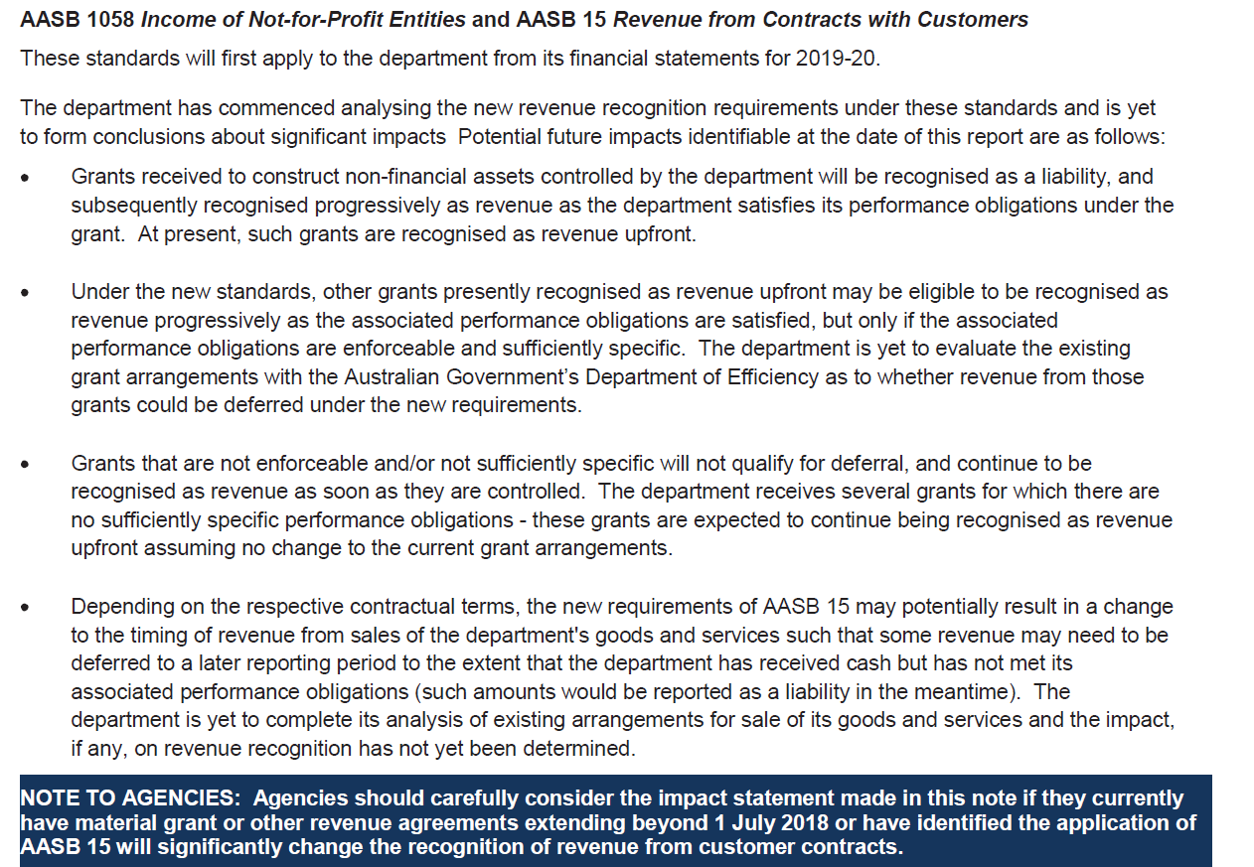
Future impact of accounting standards not yet effective
Example Queensland disclosure
Source: Queensland Treasury Financial Reporting Requirements for Queensland Government Agencies (from 1 July 2016)

Slide 9
Revenue and income sources

Slide 10
Revenue and income sources
Appropriations
Grants – Recurrent
Grants – Special purpose
Grants – Capital
Fees
Levies
User charges
Fees for service
Sale of goods
Licences
Royalties
Performance management fees
Contributed services
Capital contributions / contributed assets
Sponsorship
Taxes
Interest
Dividends

Slide 11
IFRS 15 / AASB 15 Revenue from Contracts with Customers

Slide 12
Statutory receivables
Statutory receivables initial recognition to be part of AASB 9, e.g.
  Rates
  Taxes
  Fines
Amendment in AASB2016-8 Australian Implementation Guidance for Not-for-Profit Entities (AASB 9 and AASB 15)
  Aus2.1.1 Notwithstanding paragraph 2.1, in respect of not-for-profit entities, the initial recognition and measurement requirements of this Standard apply to non-contractual receivables arising from statutory requirements as if those receivables are financial instruments.

Slide 13
Revenue recognition changes
Accounting for grant income
Conceptual change from AASB 1004
Grantor
Under new standards, the grant may be eligible for deferral where the grantor directs the benefits provided to the public / third parties
Under AASB 1004, it must be a reciprocal transfer for the grant income to be deferred
Grant funds
Benefits
Grantee / Recipient
Benefits
Public / Third parties
Notes:
Under the current accounting standard not for profit entities that receive significant grant funding will record the grant as revenue when funding is received.
This is because the recipient of the grant then has control over those funds – they have effectively gifted these funds regardless of any imposed conditions.
There have long been complaints that this distorts the bottom line and the cash inflow is not being matched with the cash outflow.
And the distortion in the bottom line can lead to adverse future consequences.
Under the revised revenue standard there may be some ability for the grant revenue to be deferred to a future accounting period.
But this only applies to reciprocal grants. If its non-reciprocal – so a donation or a gift – it cannot be deferred.

Slide 14
Implications for NFP entities – AASB 15
Apply AASB 15 if contract:
is enforceable
has sufficiently specific performance requirements and
counterparty is a customer
Notes:
Too much detail in the slide, can we reduce to dot points and include the detail in the guides? – updated 14/3

Slide 15
Revenue—AASB 15
Effective financial years beginning on, or after
  1 January 2018 (for-profit)
  1 January 2019 (not-for-profit)
Not-for-profit and public sector—to use same private sector model
Core principle
  ‘an entity shall recognise revenue to depict the transfer of promised goods or services to customers in an amount that reflects the consideration to which the entity expects to be entitled in exchange
  for those goods or services.’
May affect when entities recognise revenue, and how much they can recognise as revenue

Slide 16
Planning ahead
New standards in effect
Renegotiation and agreement finalisation
1 year agreement
Recalculated comparatives on adoption new standard
Renegotiation and agreement finalisation
1 year agreement
1 year agreement
1 July 2017
1 July 2018
1 July 2019
Note: Replace July with January for entities with 31 December year ends.
Notes:
If entities want to start matching income and expenses once the new standards come into effect, they need to start planning out the necessary conditions of their grant agreements that will allow them to defer revenue.
E.g. if the entity is negotiating 3-year (or longer) grant that is due to start in 2016-17, the entities would need to consider now how they’d like the grant to be accounted for in 2019-20 onwards.

Slide 17
Licences
AASB 15 includes guidance on licences
  Intellectual property
AASB 1058 Income for Not-for-profit entities
  Excludes licences outside the scope of AASB 15
What happens with
  Builder licences
  Drivers licences
  Application fees

Slide 18
AASB 15 Revenue recognition model
1. Identify the contract(s) with a customer
  Including contract modifications
  Principal vs. agent
2. Identify the performance obligations in the contract(s)
  What are you promising to deliver?
    – Distinct goods or services, or distinct bundle
  Unit of account determines when revenue is recognised

Slide 19
AASB 15 Revenue recognition model
3. Determine the transaction price
  Variable consideration—bonuses, penalties, discounts, concessions
  Constraint—’highly probable that a significant reversal in the amount of cumulative revenue recognised will not occur’
4. Allocate the transaction price to the performance obligations
  Dealing with bundles
5. Recognise revenue when (or as) the entity satisfies each performance obligation
  At a point in time (e.g. sale of goods), or
  Over time (e.g. construction services)
    – Measuring progress

Slide 20
AASB 15 - additional issues
Principal versus agent
Contract costs
Options and material rights
Breakage
Significant financing component
Non-cash consideration
Payments to customers
Warranties
Repurchase agreements
Bill-and-hold arrangements
Right of return exists
Onerous contracts
Licences of intellectual property

Slide 21
Examples
Construction:
Design
Site clearing
Procurement
Construction
Installation of facilities
Landscaping
Electrical goods:
TV
DVD player
Extended warranty

Slide 22
Examples
Audit services:
When is audit completed?
Legal services:
‘No win no fee’
When is control passed?
  – On settlement?
  – During services?
Revenue constraint
Joining fees/application fees:
Not providing any services
Educational services:
Over time—what portion?
Non-refundable fees
Capitalisation of costs

Slide 23
Examples
Sufficiently specific in AASB15
Specific number of counselling sessions / hours
Are these sufficiently specific?
Funds must be used in accordance with the entity’s overall objectives
Funds to be spent within defined period
Funding for facilities to be open to the public
Holding an arts festival
Research activities
Social impact bonds / social benefit bonds

Slide 24
AASB 1058 Income for Not-for-profit Entities

Slide 25
Enforceable agreement (AASB 15)
Example of terms that would normally make the agreement enforceable:
  refund obligation if money not spent in accordance with agreement
  right to enforce performance or claim damages
  any alternative uses of funds must be agreed with the grantor
Notes:
Enforceable agreement is usually a legal contract
Enforcement mechanisms may also arise from administrative arrangements or statutory provisions, e.g. minister’s directive to a department

Slide 26
Sufficiently specific promise (AASB 15)
The promise to transfer goods or services must be sufficiently specific to be able to determine when the obligation is satisfied
Consider whether the agreement specifies the following:
  nature or type of the goods or services
  cost or value of the goods or services
  quantity of the goods or services
  period over which the goods or services must be transferred
An area of significant judgement – Examples
Notes:
No specific number or combination of these conditions need to be specified. In addition, there may be other conditions that would also indicate the promise is sufficiently specific
A specified period alone (e.g. grants must be spent during 2017-18 financial year or else be returned) does not create a sufficiently specific promise
An acquittal process (e.g. regular reports on progress) may provide evidence that the promise is sufficiently specific

Slide 27
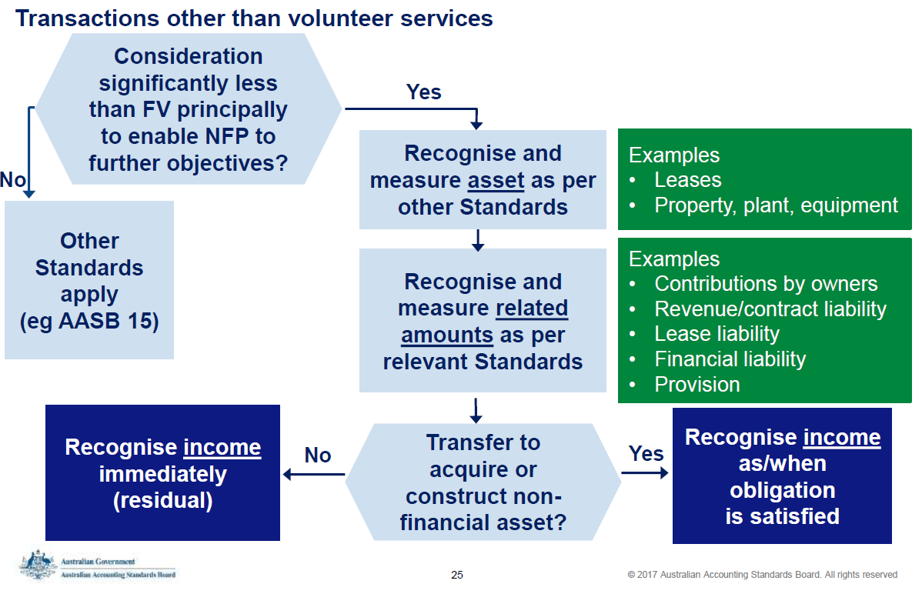
Capital grants
Source: Income of not-for-profit entities – Getting to know AASB 1058,
http://www.aasb.gov.au/admin/file/content102/c3/AASB%201058_Apr2017.pdf

Slide 28
Volunteer services
Applies to local governments, departments, GGS and WoG
Recognise revenue and expense/asset if:
  fair value of the services can be measured reliably
  services would have been purchases if they had not been donated
(intended to be) Same requirement as FRRs
Notes:
AASB 1058 also allows a entity to elect to recognise volunteer services whether or not they would have been purchases if not donated. However FRRs would not likely allow this option.

Slide 29
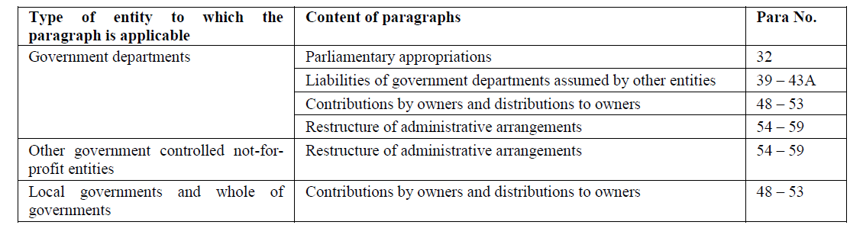
Portions AASB 1004 retained

Slide 30
Transition
New standards in effect
Renegotiation and agreement finalisation
1 year agreement
Recalculated comparatives on adoption new standard
Renegotiation and agreement finalisation
1 year agreement
1 year agreement
1 July 2017
1 July 2018
1 July 2019
Note: Replace July with January for entities with 31 December year ends.
Notes:
If entities want to start matching income and expenses once the new standards come into effect, they need to start planning out the necessary conditions of their grant agreements that will allow them to defer revenue.
E.g. if the entity is negotiating 3-year (or longer) grant that is due to start in 2016-17, the entities would need to consider now how they’d like the grant to be accounted for in 2019-20 onwards.

Slide 31
Transition
Comparatives
  Yes or no?
Up-front to deferral
  Do not have to recalculate opening balance
  Up-front under AASB 1004 = completed contract
  Apply to all completed contracts
Assets acquired for significantly less than fair value
  Assets at nil or nominal were previously caught at fair value under AASB 1004
  Peppercorn leases
    Past – mixed practice
    New standard - no exemption – fair value

Slide 32
Disclosures
AASB 15
AASB 1058

Slide 33
Future impact of accounting standards not yet effective
Source: Queensland Treasury Financial Reporting Requirements for Queensland Government Agencies (from 1 July 2016)

Slide 34

Are you AASB 1058 / AASB 15 ready?
What are your revenue, income and grant sources?
Which sources involve activities in a different financial year to when the money is received?
How will your accounting change? E.g. from up-front to deferral?
Do you have systems to determine how much to recognise and how much to defer?
Will you be preparing comparatives in the first year of application?
Notes:
So if your entity has significant grant funds - accounting treatment will change from 2019 - you will need to request a paper to be included a future meeting.
This paper needs to identify the
types of grant funding,
when and how it will be spent and over what financial years
and if there is a proposed accounting change.
Review the grant funding agreement T&Cs to ensure it is actually a reciprocal grant.
Often discussed as a reciprocal grant, but the legal agreement doesn’t support that
If that applies to your grant you now have a couple of years to get those grant agreements rewritten in your favour.
sceptical of any changes because of that motivation to account for a grant to manufacture a result.

Slide 35
Q&A
Notes:
Questions page – please remove if questions are not relevant.

Slide 36
IFRS 16 / AASB 16 Leases

Slide 37
Current lease accounting
Finance leases
Equivalent to borrowing and buying the asset
Finance lease liability
Finance lease asset
Operating leases
Rent of an asset - expense payments

Slide 38
We did we need the change?
‘One of my great ambitions before I die is to fly in
an aircraft that is on an airline’s balance sheet’
  Sir David Tweedie, Chairman of the International Accounting Standards Board (IASB), April 25, 2008

Slide 39
Operating leases in practice
What operating leases do you have?
Lessee? Paying rentals
Lessor? Receiving rentals

Slide 40
Making life easier - Exemptions
Short-term lease
  Lease term 12 months or less
  No purchase option
Low value
  Guidance - approx. USD $5,000
  Assessed as if new
  “Separate” asset
  Asset recognition thresholds?
No need to assess materiality

Slide 41


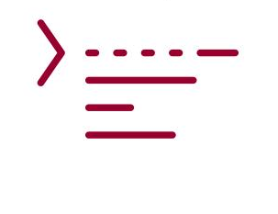
Putting operating leases on balance sheet
Effective financial years beginning on, or after, 1 January 2019
Finance lease accounting based
Determine term
Determine rental payments (cash flows)
Determine discount rate
Recognise
Lease liability
  – lease interest
Lease asset (right-to-use asset)
  – depreciation
Parallel universe

Slide 42
Lease liability—discounted cash flows
 | 1-Jul-10
1-Jul-10 | 1,000,000
1-Jul-11 | 1,000,000
1-Jul-12 | 1,000,000
1-Jul-13 | 1,000,000
1-Jul-14 | 1,000,000
1-Jul-15 | 1,000,000
1-Jul-16 | 1,000,000
1-Jul-17 | 1,000,000
1-Jul-18 | 1,000,000
1-Jul-19 | 1,000,000
NPV 5% | 1-Jul-10 | 7,848,186

Slide 43
Lease accounting

Slide 44
Profit or loss effect

Slide 45
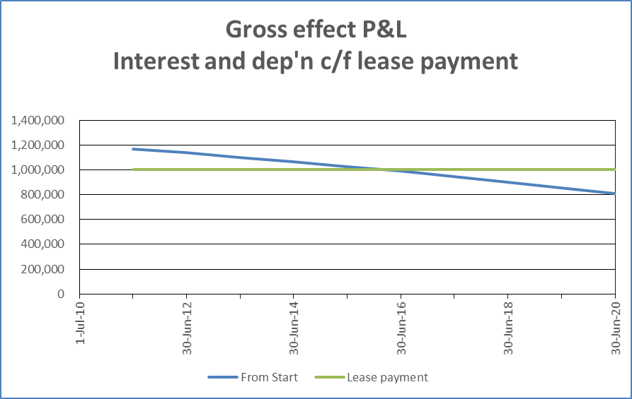
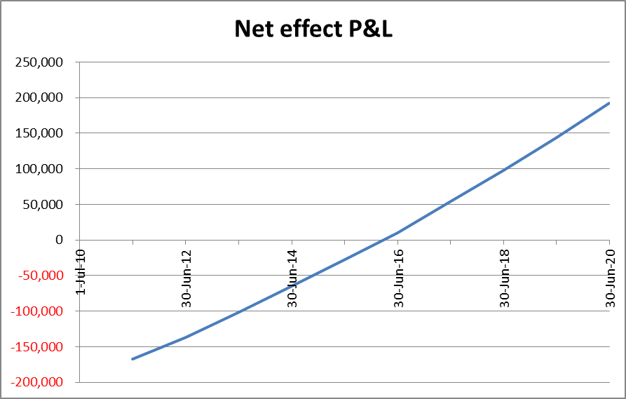
Profit or loss effect

Slide 46
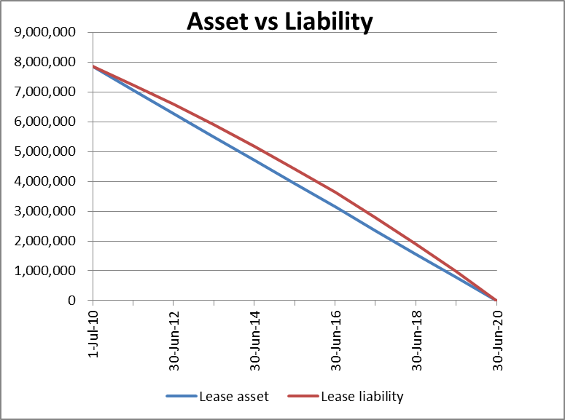
Balance sheet

Slide 47
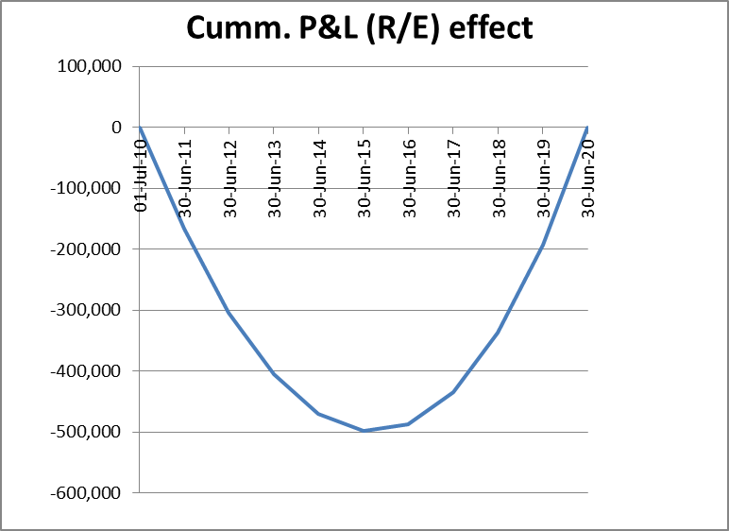
Balance sheet

Slide 48
Profit or loss statement
Sales revenue | www,www
Interest income | www,www
Other income | www,www
Raw materials and inventories | www,www
Employee expenses | www,www
Operating lease payments | www,www | Down
Selling and marketing | www,www
Administrative expenses | www,www
EBITDA | www,www | Up
Depreciation and amortisation | www,www | Up
EBIT—earnings before interest and tax | www,www | Up
Interest expense | www,www | Up
Profit before tax | www,www | Depends
Income tax expense | www,www | Depends
Profit after tax | www,www | Depends

Slide 49
Balance sheet
Current assets |  |  |  | Current liabilities
 | Cash at bank | xxx,xxx |  |  | Trade and other payables | yyy,yyy
 | Trade + sundry receivables | xxx,xxx |  |  | Provisions | yyy,yyy
 | Inventories | xxx,xxx |  |  | Loans and borrowings | yyy,yyy | Up
 | Other assets | xxx,xxx |  |  | Total current liabilities | yyy,yyy | Up
 | Total current assets | xxx,xxx
 |  |  |  | Non-current liabilities
Non-current assets |  |  |  |  | Provisions | yyy,yyy
 | Property, plant, and equipment | xxx,xxx | Up |  | Loans and borrowings | yyy,yyy | Up
 | Intangibles | xxx,xxx |  |  | Deferred tax liabilities | yyy,yyy
 | Deferred tax assets | xxx,xxx | Up |  | Total non-current liabilities | yyy,yyy | Up
 | Other | xxx,xxx
 | Total non-current assets | xxx,xxx | Up | Total Liabilities |  | yyy,yyy | Up
Total assets |  | xxx,xxx | Up | Equity
 |  |  |  |  | Contributed equity | zzz,zzz
 |  |  |  |  | Reserves | zzz,zzz
 |  |  |  |  | Retained earnings | zzz,zzz | Down
 |  |  |  | Total equity |  | zzz,zzz | Down

Slide 50
Cash flow statement
Cash flows from operating activities
 | Receipts from customers | vvv,vvv
 | Payments to suppliers and employees | vvv,vvv | Down
 | Interest received | vvv,vvv
 | Interest paid (option) | vvv,vvv | Up
 |  | vvv,vvv
Cash flow from investing activities
 | Payments for property, plant, and equipment | vvv,vvv
 | Cash received on disposal of subsidiaries | vvv,vvv
 | Proceeds from sale of PPE | vvv,vvv
 |  | vvv,vvv
Cash flows from financing activities
 | Repayment of borrowings | vvv,vvv | Up
 | Dividend paid | vvv,vvv
 | Interest paid (option) | vvv,vvv | Up
 |  | vvv,vvv
Net cash flows |  | vvv,vvv | Same

Slide 51
Ratios—impact
Ratio | Ratio formula | Effect
Working capital ratio | Current Assets Current Liabilities | Lower
Gearing ratio | Interest Bearing Liabilities Equity | Higher
Net profit margin | Net profit after tax Sales | Financing effect
Return on assets | EBIT Assets | Financing effect—profit Higher assets
Return on equity (return on capital employed) | Net profit after tax Equity | Financing effect—profit Lower equity
Earnings per share | Net profit after tax Number of shares | Financing effect

Slide 52
CPI adjustments
 | 2015-16 | 2016-17 | 2017-18 | 2018-19
Federal | 2.5 | 2.5 | 2.5 | 2.5
New South Wales | 2.5 | 2.75 | 2.5 | 2.5
Queensland | 2.25 | 2.5 | 2.5 | 2.5
Tasmania | 2.25 | 2.5 | 2.5 | 2.5
South Australia | 2.5 | 2.5 | 2.5 | 2.5
Victoria | 2.75 | 2.75 | 2.5 | 2.5
Western Australia | 2.25 | 2.5 | 2.5 | 2.5
ACT | 2.0 | 2.5 | 2.5 | 2.5
Northern Territory | 2.5 | 2.3 | 2.5 | 2.5
Source: Federal, State and Territory budgets 2015-16, forecasts, estimates, projections

Slide 53
CPI adjustments
 |  | 2015-16 | 2016-17 | 2017-18 | 2018-19 | 2019-20
2015-16 Budget | Federal | 2.5 | 2.5 | 2.5 | 2.5
2015-16 Actual | Federal | 1.0
2016-17 Budget | Federal |  | 2.0 | 2.25 | 2.5 | 2.5
2015-16 Budget | ACT | 2.0 | 2.5 | 2.5 | 2.5
2015-16 Actual | ACT | 0.8
2016-17 Budget | ACT |  | 1.0 | 2.5 | 2.5 | 2.5
2015-16 Budget | Queensland | 2.25 | 2.5 | 2.5 | 2.5
2015-16 Actual | Queensland | 1.6
2016-17 Budget | Queensland |  | 2.0 | 2.5 | 2.5 | 2.5
Source: ABS Publication 6401.0 June 2016
Federal, State and Territory budgets 2016-17, forecasts, estimates, projections

Slide 54
Operating leases—why things are different
 | 1-Jul-10
1-Jul-10 | 1,000,000
1-Jul-11 | 1,000,000
1-Jul-12 | 1,000,000
1-Jul-13 | 1,000,000
1-Jul-14 | 1,000,000
1-Jul-15 | 1,000,000
1-Jul-16 | 1,000,000
1-Jul-17 | 1,000,000
1-Jul-18 | 1,000,000
1-Jul-19 | 1,000,000
 | 1-Jul-11
1-Jul-11 | 1,020,000
1-Jul-12 | 1,020,000
1-Jul-13 | 1,020,000
1-Jul-14 | 1,020,000
1-Jul-15 | 1,020,000
1-Jul-16 | 1,020,000
1-Jul-17 | 1,020,000
1-Jul-18 | 1,020,000
1-Jul-19 | 1,020,000
Changed rent
NPV 5% | 1-Jul-10 | 7,848,186
NPV 5% | 30-Jun-11 | 7,231,114
7,375,737

Slide 55
Lease re-measurement (for example, CPI)

Slide 56
Lease payments—CPI
Only include in lease liability when rentals change
When do rentals change?
1 January
1 July
Anniversary of commencement

Slide 57
Lease payments—contingent payments
Include fixed payments in lease liability
Recognise variable payments when they occur
  – e.g. turnover rent, usage rent
Some lease rentals included in lease liability. Some are not
May still have a lease payments expense

Slide 58
Business combinations
Operating leases acquired treated as a new lease
Financing effect
MOG Changes

Slide 59
Lease term – Renewals and options
Do you include option renewals in the lease term for the commitments note?
If so, what factors do you currently consider?

Slide 60
Lease term – Renewals and options
When should you include option renewals?
  Probable (>50% - more likely than not)
  Highly probable
  Reasonably certain
  Virtually certain
  When exercise option
  Significant economic incentive
  Probability weighted (i.e. 30% likely, use 30% payments)

Slide 61
Lease term – Reasonably certain
Lease asset
  Can extend without lessor consent
  If an asset, then include obligation to pay
  Management intention?
Lease liability
  Is there an obligation to exercise?
  What if not profitable?
  Should the payments be included as a liability?

Slide 62
Transition – Methods
No later than financial years beg. 1 Jan 2019
Cumulative catch-up (change current year only)
Choices to ease calculations
  Lease-by-lease
Start in year of initial application
  No comparatives – maybe disclosures
Lease liability
  Current incremental borrowing rate
  Can use portfolio rate (for similar leases)
Lease asset
  Starts same as liability (initial application date)
    Means future hit to profits for the retained earnings difference not recognised (compared to accounting from lease commencement)
  IASB allows you to go back to lease commencement, using current discount rate
    Reduce front-ending of expenses for future results
    Need to account for reassessments and modifications
    Modifications – use current discount rate

Slide 63
Transition
Lease – commences - 1 July 2013
  $1,000,000 pa., 10 years, 5% discount rate
Business combination - 1 July 2016
Transition date – 1 July 2019
 |  |  | Legal | Asset | Liability | R/earnings
 |  | Group | subsidiary | 1-Jul-19 | 1-Jul-19 | (no tax effect)
1-Jul-13 | Legal subsidiary commencement date |  | X | 3,138,414 | 3,625,715 | -487,301
1-Jul-16 | Business combination date | X |  | 3,370,465 | 3,625,715 | -255,250
1-Jul-19 | Date of initial application | X | X | 3,625,715 | 3,625,715 | 0

Slide 64
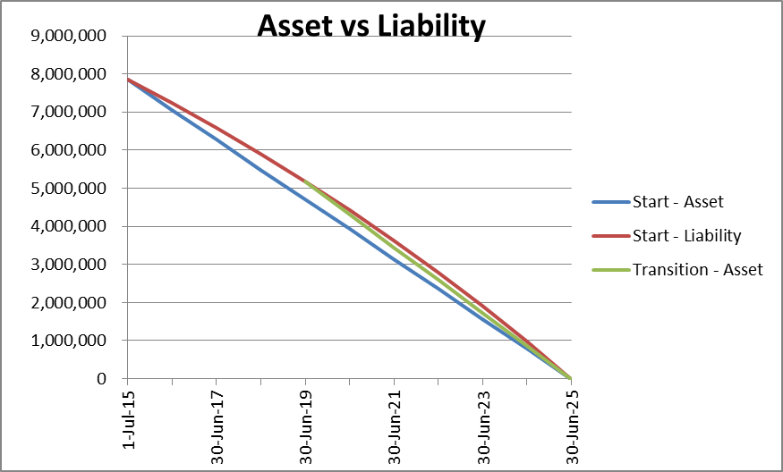
Transition

Slide 65
Transition issues
Definition of a lease
Payments – incl. remeasurements and modifications
Discount rate & portfolio approach
Exemptions – short-term and low value
Exercise of options
Initial direct costs

Slide 66
Revaluations
Treat like property, plant and equipment
Can revalue, if class of PPE revalued
What is the fair value of 3 floors of a building with 5 years of the lease remaining?
AASB 1049 + financial reporting requirements

Slide 67
Peppercorn and below-market rentals
AASB 1058 Income for NFPs
  Recognise at fair value
What is the fair value of 3 floors of a building with 5 years of the lease remaining?

Slide 68
Q&A
Notes:
Questions page – please remove if questions are not relevant.

Slide 69
IFRS 9 / AASB 9 Financial Instruments

Slide 70
Complexity of the former standard
(IAS 39 / AASB 139)
‘Those that tell me they understand IAS 39,
clearly haven’t read it properly’
    Sir David Tweedie, Chairman of the International Accounting Standards Board (IASB), FEE Seminar, Brussels, 1 December 2005

Slide 71
IFRS 9 / AASB 9 Financial Instruments
Classification and measurement
  Was supposed to reduce complexity
Impairment
  Back to general provisions
Liabilities through P&L – Credit risk to OCI
Derivatives
Hedging
  Simpler
  Removing the 80 / 125 rule
Set-off

Slide 72
Classification of financial assets
Source: EY Applying IFRS - IFRS 9 for non-financial entities (March 2016), page 5

Slide 73
General approach for impairment of financial assets
Source: EY Applying IFRS - IFRS 9 for non-financial entities (March 2016), page 15

Slide 74
Public sector issues
Interest free loans (classification and measurement)
  Defined term
  Early repayment option
Non-recourse loans (classification and measurement)
Investments (classification and measurement)
  Debt instruments like bonds
Impairment for loans to government entities
  Federal – AAA rating
  Queensland – AA rating
  AAA corporates do default
  Governments do default
    Australia defaulted in 1931

Slide 75
Q&A
Notes:
Questions page – please remove if questions are not relevant.

Slide 76
AASB 1059
Service Concession Arrangements: Grantors

Slide 77
Examples
ACT
ACT Law Courts Facilities
Canberra Light Rail Project
Local Hospital Network
Other AASB 1059 examples
Prisons
Airports
Water distribution facilities
Energy supply networks
Telecommunication networks
Military bases
Registries and databases
Queensland
Toll roads
  Incl. land under roads, bridges, land under bridges, tunnels
Gold Coast Rapid Transport
Airport rail link
Rail rolling stock
Buildings – Education (TAFE, schools)
Buildings – Hospital
Buildings – Car parks
Child care centre
Student accommodation

Slide 78
History
Date | Body | Publication
Sep 1998 | UK ASB | FRS 5 Reporting the Substance of Transactions Application Note F Private Finance Initiative and Similar Contracts
Dec 2001 | IASB | SIC-29 Disclosure – Service Concession Arrangements
Jul 2004 for Jan 2005 | AASB | UIG Interpretation 129
Dec 2006 for Jan 2008 | IASB | IFRIC 12 Service Concession Arrangements (Operators)
Dec 2011 for Jan 2014 | IPSASB | IPSAS 32 Service Concession Arrangements: Grantor
Notes:
Too much detail in the slide, can we reduce to dot points and include the detail in the guides? – updated 14/3

Slide 79
Effect
Asset
  Current replacement cost
    Including land under roads and intangibles (excluding goodwill)
    Then usual policy
Liability
      Grant of a right to the operator model
        E.g. toll roads
        Recognise as unearned revenue over period
      Financial liability
        E.g. buildings
        Future contractual obligations (like finance lease)
      Hybrid
Initial recognition
  When gain control (not practical completion)
Life cycle costs
Notes:
Too much detail in the slide, can we reduce to dot points and include the detail in the guides? – updated 14/3

Slide 80
Which arrangements are caught?
2 This Standard shall be applied to service concession arrangements, which involve an operator:
(a) providing public services related to a service concession asset on behalf of a grantor; and
(b) managing at least some of those services under its own discretion, rather than at the direction of the grantor.
5 … The grantor controls the asset if, and only if:
(a) the grantor controls or regulates what services the operator must provide with the asset, to whom it must provide them, and at what price; and
(b) the grantor controls – through ownership, beneficial entitlement or otherwise – any significant residual interest in the asset at the end of the term of the arrangement.
operator The entity that has a right of access to the service concession asset to provide public services
Notes:
Too much detail in the slide, can we reduce to dot points and include the detail in the guides? – updated 14/3

Slide 81
Quarterly Service Payments (QSP)
Repayment of construction costs (principal and interest)
Payment for services (cleaning, security services, and building maintenance services)
Payment for capital lifecycle replacements
Payment of utilities costs (water, electricity)
Notes:
Too much detail in the slide, can we reduce to dot points and include the detail in the guides? – updated 14/3

Slide 82
Lifecycle payments (QSP)
Planned capital replacement of building components
  Possibly including plant and equipment
Payments are separate to the ongoing building maintenance
Identified in Base Case Financial Model
  PPP entity takes risks of replacement (earlier or later, lower or higher)
    May have some limits
  QSPs may match expected outflow by PPP entity. Maybe straight-lined
Payments will not match actual replacement
Current diversity
  Expense as incurred
  Capitalise all future payments upfront
  Capitalise and match against planned replacements
Notes:
Too much detail in the slide, can we reduce to dot points and include the detail in the guides? – updated 14/3

Slide 83
Valuation issues
Current replacement cost mandated
  Will this always comply with AASB 13?
Lifecycle payments
  What has been included in the valuation?
Public sector issues
  Finance / borrowing costs
  Market participant
    Replace with another PPP?
    Self-construct?
Notes:
Too much detail in the slide, can we reduce to dot points and include the detail in the guides? – updated 14/3

Slide 84
Transition
Restated amounts
New standard
1 July 2018
1 July 2019
1 July 2020
Note: replace July with January for entities with 31 December year ends
Retrospective or from date of initial application
  All or nothing - Not asset by asset like AASB 16 Leases
Asset
  Current replacement cost
Liability
  Financial liability
    Discounted future payments
  Unearned revenue - Grant of a right to the operator model
    Adjusted to reflect the remaining period of the service concession arrangement relative to the remaining economic life of the asset
Accumulated surplus / Retained earnings
  Asset revaluation reserve?

Slide 85
Q&A
Notes:
Questions page – please remove if questions are not relevant.

Slide 86
Thank you

