Slide 1
2017-18
FINANCIAL AUDIT SEMINAR

Slide 2
WELCOME
Dr Maxine Cooper, Auditor-General

Slide 3
Financial Audit Season Again!
Source: all-free-download.com

Slide 4
Address by the Deputy Chair,
Standing Committee on Public Accounts
Mr Michael Pettersson, MLA

Slide 5
Results of the 2016-17 Audit Program
Mr David O’Toole
Senior Audit Manager, Financial Audits

Slide 6
2016-17 Financial Audits – Overview
(Report No. 10/2017)
Summary results of the:
audits of 55 financial statements; and
reviews of 25 statements of performance.
Overall assessments of the quality and timeliness of reporting.

Slide 7
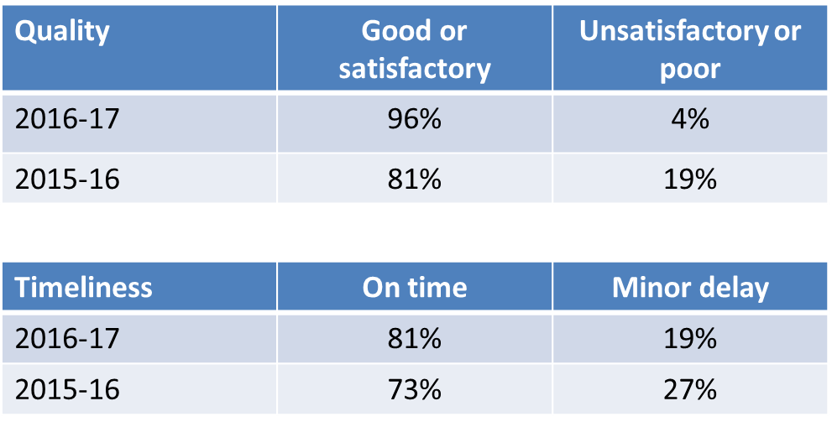
Quality and timeliness of financial statements
No qualified audit reports in 2016-17 or in 2015-16.

Slide 8
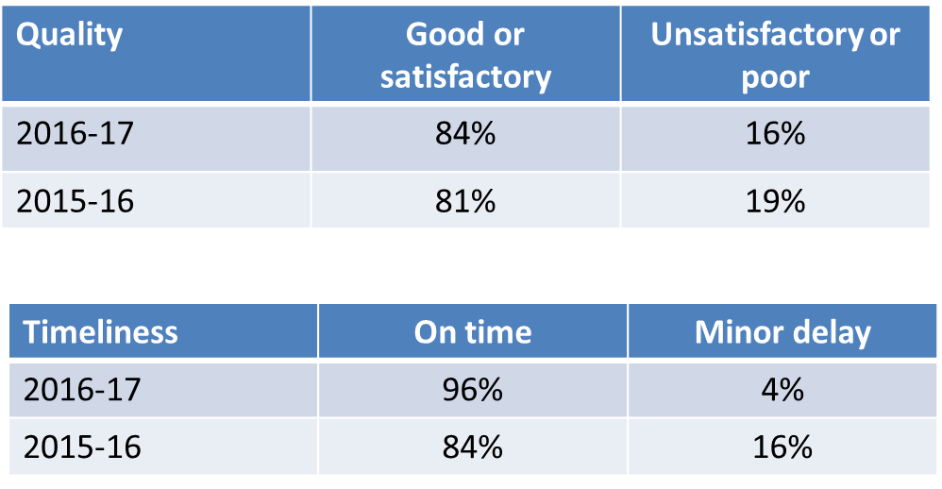
Quality and timeliness of statements of performance
No qualified reports of factual findings in 2016-17 or in 2015-16

Slide 9
Accuracy and timeliness of annual reports
Most reporting agencies included accurate versions of the financial statements and statement of performance in their annual reports.
Six agencies corrected errors in their annual report after publishing (mainly omitted information)
Three agencies placed their annual reports on websites a day after the due date

Slide 10
2016-17 Financial Audits – Financial Results and Audit Findings (Report no. 11/2017)
Report has a discussion of:
the Territory’s financial results;
agencies’ performance in resolving audit findings;
financial results and audit findings of selected reporting agencies.
Recommendations are made in audit management reports to ACT Government agencies.

Slide 11
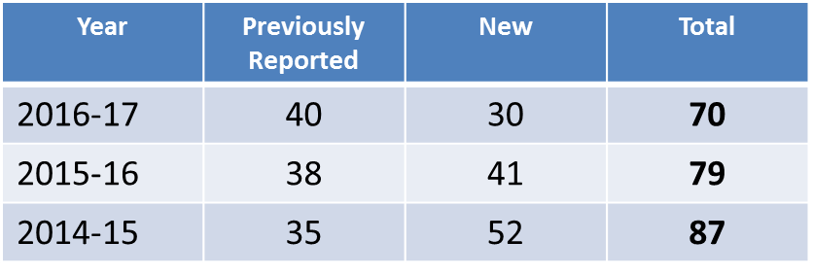
Audit findings

Slide 12
Audit findings
Internal Control Weaknesses
reviews of payroll reports
satisfactory receipt of goods and services on invoices
authorisation and documentation of travel and hospitality expenses
Reporting
variance explanations unclear and not informative
incorrect accounting treatments
accountability indicators not properly explained in budget or statement of performance

Slide 13
2016-17 Financial Audits – Computer Information Systems (Report no. 4/2018)
Results of reviews of general controls over computer information systems and controls over specific major applications.
Computer information controls were overall satisfactory, however, some controls require strengthening.

Slide 14
Weaknesses in CIS controls
General controls
weaknesses in governance arrangements
management of the security of information
business continuity and disaster recovery arrangements
Controls over specific major applications
management of information security
business continuity and disaster recovery arrangements
change management process

Slide 15
Questions?
More information on the results of the 2016-17 financial audit program can be found in the following public reports:
2016-17 Financial Audits – Overview (Report no. 10/2017)
2016-17 Financial Audits – Financial Results and Audit Findings (Report no. 11/2017)
2016-17 Financial Audits – Computer Information Systems (Report no. 4/2018)
Website link
http://www.audit.act.gov.au/reports.html

Slide 16
Key messages for 2017-18 reporting
Mr Saman Mahaarachchi
Senior Audit Manager, Financial Audits

Slide 17
Key Messages
Related party disclosures
Certification of statements
Audit Management Reports
Standards issued not yet effective
Decluttering/Materiality
Facilitating an efficient audit process

Slide 18
Related Party Disclosures
Who are Key Management Personnel ?
Declarations
not received / completed
Acting arrangements
if significant related party transactions were entered into during the acting period

Slide 19
Certification of Statements
FMA requirements
Draft statements with covering letter
Audit close reports – issued close to the issue of audit reports
Certification process – avoid unnecessary delays

Slide 20
Audit Management Reports
Interim and final management reports
Exit meeting - matters to be reported
Management comments to be provided in a timely manner
Auditing standard requirements to close audit files within 60 days of audit reports

Slide 21
Standards Issued Not Yet Effective
Identify standards applicable to your agency
Assess whether there may be a material financial and disclosure impact
Document the assessment - Prepare work papers
Disclose details of the standards / interpretations which apply and the impact

Slide 22
Standards Issued Not Yet Effective
e.g. AASB 15 : ‘Revenue from Contracts with Customers’ (1 Jan 2019 for not-for-profit entities).
...currently assessing the impact of this standard … Document the assessment undertaken todate
…. at this stage ….is not able to estimate the impact… and will make a more detailed assessment … Document the reasons for not being able to assess the impact
Assessment not made or not documented may result in a potential audit finding

Slide 23
Decluttering/Materiality
Agencies to check whether material information are obscured with immaterial information
Agencies should reassess whether immaterial information are needed to help users understand the financial results
Further emphasis on decluttering and materiality is in Model FS

Slide 24
Facilitating an Efficient Audit Process
Communication of issues
Key audit contacts listed in audit strategy
Timely feedback can improve the audit process
Periodic meetings/catch-up
Key agency contacts for audit
Accounting position papers
for significant/material arrangements and transactions
seek expert advice early if needed and issue written instructions
Shell statements should include all known significant changes

Slide 25
Facilitating an Efficient Audit Process
Audit workpapers
Should be available to the audit team at the time FS and SOP are provided for audit
Provide the basis for information included in FS and SOP
Should be independently reviewed
May be electronic or in hard copy
Accommodation for audit teams
Should meet relevant WHS requirements

Slide 26
Questions?

Slide 27
Changes to Australian Accounting Standards
From 2017-18
Alastair Higham
Senior Director
Professional Services and Relationships Group

Slide 28
2018-19

Slide 29
Financial Instruments
AASB 9

Slide 30
Why A New Standard?
Global financial crisis
Measure financial assets based on the entity business model
Earlier recognition of credit losses

Slide 31
Measuring Financial Assets
What’s your business model?
Hold to collect principal and interest
Hold to collect principal and interest and to sell
Other eg held for trading
Amortised Cost
Fair value through Other Comprehensive Income
Fair Value through P&L

Slide 32
Impairment
Has there been a significant increase in credit risk since initial recognition?
YES
NO
Recognise lifetime expected credit losses
Recognise 12 month expected credit losses
Expected losses from all default events over the life of the instrument
Expected losses from default events occurring in the next 12 months

Slide 33
Assessing Increased Credit Risk
General rule: compare the risk of a default event at initial recognition with the risk at reporting date
Special rules:
if instrument is low risk at reporting date, assume risk has not increased
rebuttable presumption that payments more than 30 days overdue have increased credit risk.

Slide 34
Measuring Credit Losses
Take into account:
unbiased, probability-weighted outcomes
time value of money
reasonable and supportable information, available without undue cost or effort, about past, present and future conditions
collateral

Slide 35
Simplified Approach
Does not require the tracking of changes in credit risk
Requires recognition of lifetime ECLs at all times
Applies to trade receivables and contract assets, as long as they do not contain a significant financing component

Slide 36
Implications
Identify your business model for holding each type of financial asset
Develop procedure for:
identifying changes in credit risk
measuring expected credit losses

Slide 37
2019-20

Slide 38
Income of Not-for-Profit Entities

Slide 39
Accounting For Inflows
For these transactions | When you initial recognise an asset, credit…..
Sales of goods and services | Liability
Grants without performance obligations | Income
Grants with performance obligations | Liability
Capital grants | Liability

Slide 40
A Working Definition
Performance obligation | A promise to transfer goods/services in an agreement that is binding specific enough to identify when goods/services have transferred
Capital grant | A grant to acquire or construct a non‑financial asset to specifications under a binding agreement that does not require the entity to transfer the asset

Slide 41
Example - Facts
The Commonwealth provides a State Government department with a grant to build a road in the State:
there are seven project milestones in the grant agreement, expected to be met over several years
the Commonwealth provides the full amount of funding in Year 1

Slide 42
Example – Accounting
When it receives the funding, the State Government recognises a liability equal to the funding
The State Government notionally allocates the funding between milestones
As each milestone is met, the allocated amounts are transferred from liability to revenue

Slide 43
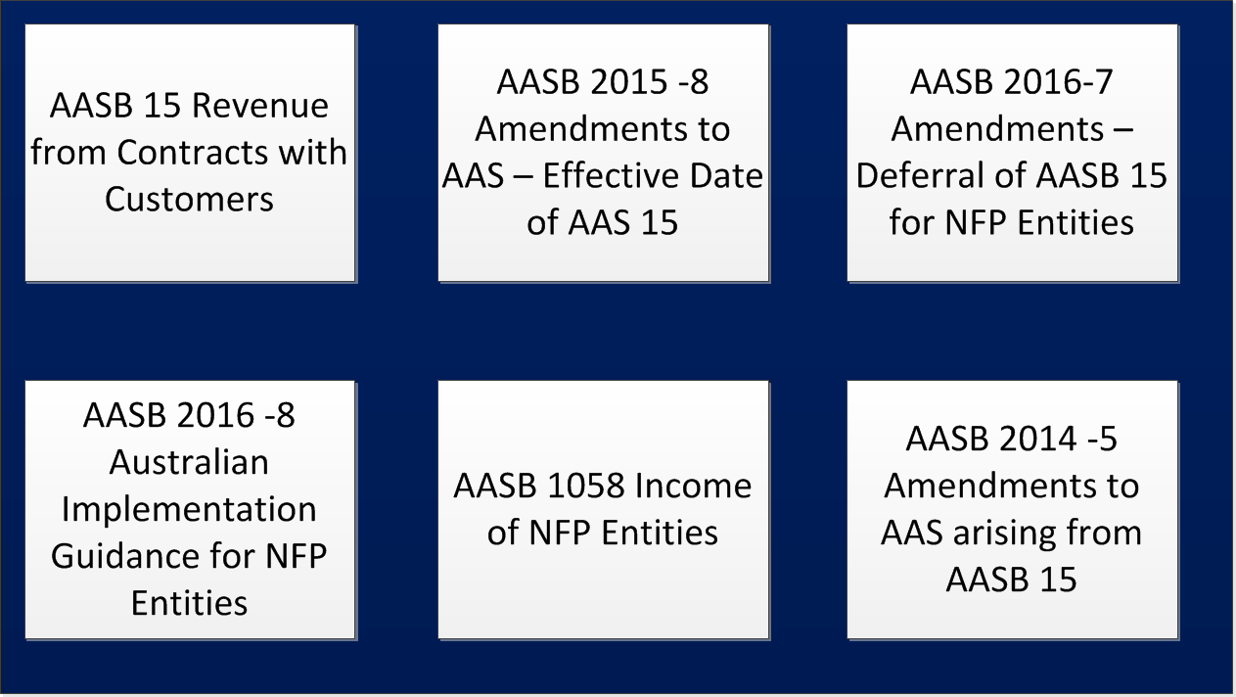
Relevant Standards

Slide 44
Leases
AASB 16

Slide 45
Why A New Standard?
A view that leases are assets of lessees and should be on the lessee’s balance sheet

Slide 46
Lessees Vs Lessors
Different rules for lessees and lessors
Lessees
Lessors
Recognise almost all leases as assets and liabilities
Continue to differentiate between finance and operating leases

Slide 47
Initial Measurement
Present value of unpaid lease payments discounted at the rate implicit in the lease
Liability
Initial direct costs of lease
Rent paid before commencement
Asset
Make good obligation
Lease incentives received

Slide 48
What Is The Lease Term?
The non-cancellable period of the lease
Options to extend if lessee reasonably certain to exercise
Options to terminate if lessee reasonably certain to exercise

Slide 49
Subsequent Measurement
Liability
Asset
1. Unwind NPV
1. Depreciate
2. Reduce for
lease payments
2. Impair
3. Remeasure
3. Adjust for
remeasurement

Slide 50
Optional Exemptions
Expense the following (systematically over the lease term e.g. straight line):
assets leased for less than 12 months (by right-of-use asset class)
assets of low value (e.g. personal computers, tablets, furniture and telephones)

Slide 51
Morning Tea

Slide 52
Changes in the 2017-18 Model Financial Statements
Mr Geoff Britt (CPA), Accountant
Financial Framework Management & Insurance (FFMI)
Economic and Financial Group
Chief Minister, Treasury and Economic Development Directorate

Slide 53
Changes in the 2017-18 Model Financial Statements
See Model Section 1.2 and the forthcoming Financial Framework Memo on 2017-18 Model Financial Statements. Model expected to be released mid-April.
Decluttering/Materiality
Further emphasis on ‘decluttering’ and attention to materiality in presentation and disclosure.
Agencies to consider materiality in preparing and streamlining their financial statements.

Slide 54
Changes in the 2017-18 Model Financial Statements
Decluttering/Materiality (Continued)
Apply judgement in determining which disclosures could be omitted on the basis that they are not quantitatively or qualitatively material. (Further guidance in Model/Memo).
See AASB Practice Statement 2 Making Materiality Judgements (December 2017).

Slide 55
Changes in the 2017-18 Model Financial Statements
Relocation of Disclosure
Controlled Disaggregated Disclosure of Assets and Liabilities moved from the Notes to directly follow the disaggregated Operating Statement for Output Classes.
This changes the Note order from previous years.
Accounting Standard Changes Impacting Model
AASB 2016-4 Amendments to Australian Accounting Standards-Recoverable Amount of Non-Cash-Generating Specialised Assets of Not-for-Profit Entities.

Slide 56
Changes in the 2017-18 Model Financial Statements
Accounting Standard Changes Impacting Model (Continued)
This amending standard:
removes references to depreciated replacement cost as a measure of value in use for not-for profit entities; and
clarifies that the recoverable amount of primarily non-cash-generating assets of not-for-profit entities, which are typically specialised in nature and held for continuing use of their service capacity, is expected to be materially the same as fair value determined under AASB 13 Fair Value Measurement (i.e. current replacement cost).

Slide 57
Changes in the 2017-18 Model Financial Statements
Accounting Standard Changes Impacting Model (Continued)
AASB 2016-2 Amendments to Australian Accounting Standards – Disclosure Initiative: Amendments to AASB 107 requires agencies to provide disclosures that enable users of financial statements to evaluate changes in liabilities arising from financing activities, including both changes arising from cash flows and non-cash changes.
Where relevant, agencies should include a reconciliation of the opening and closing balance of liabilities arising from financing activities.

Slide 58
Changes in the 2017-18 Model Financial Statements
Financial Management Act
No changes to the Model from amendments to the Financial Management Act 1996.
Model is a Guide for consistent financial reporting across the ACTPS
Agencies are encouraged to follow the format of the Model for consistency of presentation of financial statements by ACT Government agencies for key users such as the members of the Legislative Assembly.
Agencies’ financial statements are ultimately the responsibility of the D-G/CEO/Board.

Slide 59
Changes in the 2017-18 Model Financial Statements
Addendum
All changes to the Model Financial Statements are set out in the Addendum to the Model with red text (new) and strikethrough (deleted).

Slide 60
Thank You
Any Questions?
Contact: Geoff Britt 62070259
geoff.britt@act.gov.au
http://apps.treasury.act.gov.au/accounting

Slide 61
Governance and Probity
Mr David Burfoot, Senior Consultant
The Ethics Centre

Slide 62
Governance and Probity

Slide 63
3 Messages for today ethical leadership
There are more than one or two perspectives in Ethics
Brain mechanics create blind spots which affect decision making
Integrate the Ethical Framework into organisational governance

Slide 64
Ethics is…
About standing up for what you think is right and being true to yourself. | About having a gut feeling that something is right and doing that. | Thinking and talking about a situation to decide what’s best. | Being fair to people, treating them like you’d like them to treat you.
Trying to do the best for everyone involved. | Tradition way of doing things | Just common sense. | The law.

Slide 65
Ethical dilemmas and moral temptations
Moral temptation
Gray zone
Ethical dilemma
Killing |  | Lawful killing (assisted suicide, capital punishment, war)?
Lying |  | Lying to avoid hurting someone’s feelings?
Stealing |  | To feed a starving family?
Speeding |  | To save a life?
Time
Context

Slide 66
4 Common Dilemmas
Rushworth Kidder academic and journalist
Ethical Dilemmas are defined “right vs. right” and “at the heart of our toughest choices”. When people encounter these tough choices, it is rarely because they are facing a moral temptation (i.e.: right vs. wrong).
Truth vs Loyalty
Individual vs Community
Short-Term vs Long-term
Justice vs Mercy

Slide 67
UNDERSTAND HOW PEOPLE MAKE ETHICAL DECISIONS OR JUDGEMENTS

Slide 68
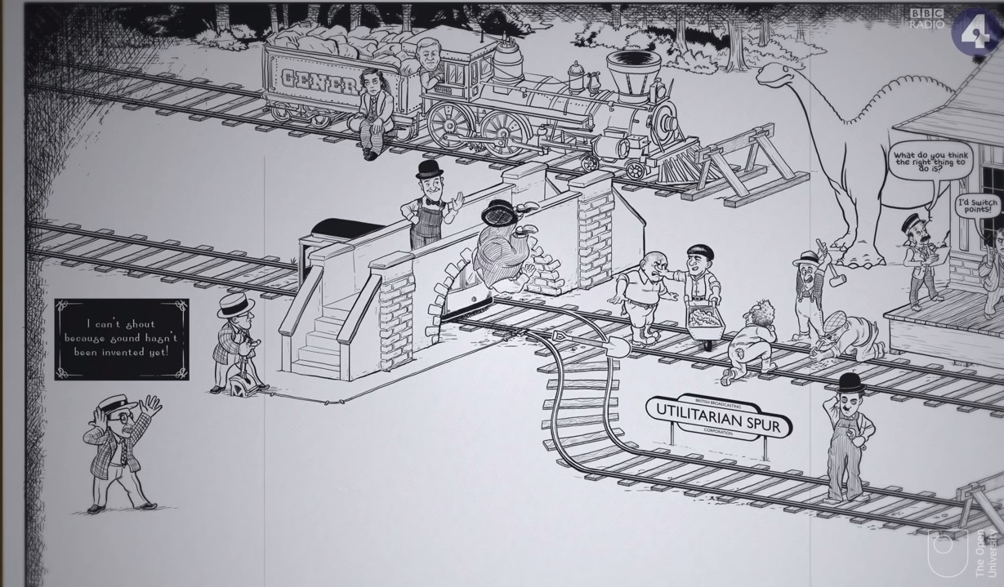
The Trolley Problem

Slide 69
3 major philosophical approaches
Virtue
Duty
Consequences

Slide 70
Cognitive Bias – HOW YOUR BRAIN CAN FOOL YOU

Slide 71
Cognitive Biases and Heuristics
Confirmation bias
Racial Stereotypes
Moral license
Self Serving Bias
Overconfidence Bias
Framing

Slide 73
Four categories of self-deception
Legalism the inability to imagine moral obligations beyond the law;
Tribalism or the belief that the company is always right;
Moral relativism the excusing of unethical practices by viewing business as "a game" and oneself as "a role";
Scientism the elevation of science-including management science-to a position of unquestioned authority
JOHN KNAPP, 1999
73

Slide 74
Ethical framework
THE ETHICS CENTRE
74

Slide 75
Shadow Values
75

Slide 76
Steps to Good Decision Making
01
What’s your gut reaction? Why?
FRAME
02
What are the facts and assumptions? What values are in play in framing the facts and assumptions
03
Are there any non-negotiables?
04
Who’s involved? What’s their perspective? What are their interests?
SHAPE
05
How should interests, needs and wants be prioritised? Why?
06
What values are clashing? Good v good – right v right – choice between poor options?
07
Brainstorm your options.
08
Norms – what is usually done in this situation? What laws/codes apply?
EVALUATE
09
Run your decisions through the Good Decisions Pathway.
10
What’s your decision? Why?
REFINE
11
Devil’s advocate/Integrity test/Mentor test
ACT
12
ACT
76
THE ETHICS CENTRE

Slide 77
Good decision pathway
 |  |  | 01 Maximises benefit over harm | 02 Would make a good universal rule | 03 Develops & maintains good character | 04 Protects fundamental moral rights | 05 Promotes care for others & relationships | 06 Promotes a common good for your purpose | 07 Applies stated values and principles | 08 You would support it in public | 09 You could live with it if it were done to you
 | Option 1
 | Option 2
 | Option 3
 |  |  |  |  |  |  | X Place a X in the circles you feel apply in each decision pathway
THE ETHICS CENTRE 2016 ©

Slide 78
Integrity and Probity Review
Ethical framework alignment
Obtaining best value
Transparency of process
Addressing Conflicts of Interest
Confidentiality
Accountability

Slide 79
ETHICAL Leadership in organisations
Comes from the top
Speak values and principles
Know:
the culture you want
how far you are from it, and
your plan for getting there
System and policy alignment
Open Communication
Long term view

Slide 81
ethics.org.au

Slide 82
2017-18 Whole-of-Government
Reporting Requirements
Ms Margaret Barnes
Senior Analyst – Financial Reporting Team
Chief Minister, Treasury and Economic Development Directorate
x75653
fabdfinancialreporting@act.gov.au

Slide 83
Timing
Shared Services Centre will provide agency statements on 13 July
Financial statements due to the Audit Office and Treasury on 16 July (Group 1) and 26 July (Group 2)
Some agencies are on differing timetables – ACTIA, CMTEDD, CTP Regulator, Icon Water Ltd, LCSF, SPA and TBA
Audit reports provided by 19 September 2018

Slide 84
Web Workbooks
Date | Open/Close | Comments
10 July | Open | Based on Oracle 7th working day
11 July | Close | Data will be consolidated for Government Finance Statistics reporting to the ABS
27 July | Open | Based on Oracle ADJ period
30 July | Close | Data will be consolidated to produce the June Quarter Report (interim outcome) and the whole of government financial statements
This data must match agency certified statements
31 July – 19 September 2018 | Open Treasury Admin | Material agency audit changes will be processed by Treasury administrators

Slide 85
Collection of Functional Government Finance Statistics Data
Effective from the 2017-18 financial reporting period the ABS has implemented a revised Government Finance Statistics Framework
This includes changes to the Classification of Functions of Government (COFOG)
Due to Treasury 25 August 2018

Slide 86
Consolidation Packs
Treasury has made some amendments to the consolidation packs which now includes additional data validations which will improve reporting and audit process
Consolidation packs based on second download (match to certified statements)
Due 1 August (Group 1) and 6 August (Group 2)

Slide 87
Key Issues – Whole of Government
Largely unchanged
Accuracy of interim outcome to financial statements
Variance explanations – this is an audit finding over several past years which is still challenging. The purpose of the explanations is to provide publishable information about why targets were not met or were exceeded. This information is tabled as part of the WhoG quarterly reports and as part of ACT Budget (BP3) as part of the Government Fiscal Strategy. These explanations need improvement, please contact the Reporting team for more information
Internal trade errors – target <$100m
2016-17 = $372m
2015-16 = $369m
2014-15 = $409m

Slide 88
Instruments/Drawdowns
Final drawdowns 26 June – no additional drawdowns will be available
Final instrument requests to Treasury by 31 May (excluding grants)

Slide 89
Closing
Upcoming Treasury memos:
Final audit timetable
Instruments and cash disbursements
Functional data reporting
More detailed training again in June
Please send your agency representatives

Slide 90
Questions?

Slide 91
Close
Mr Ajay Sharma
Acting Director, Financial Audits

Slide 92
Thank you

